Slide 1

Let’s Catch Up
This website will allow the students and other members of Cleveland State University to post about any events so that other students can get aware of the same and can register themselves to attend the event of the Cleveland State University.

Slide 2



Technologies
For front end, I am using REACT.
For database, I am using MS SQL Server
For processing the Data in backend, I am using .NET Entity Framework and I am using the Code First approach.

Slide 3
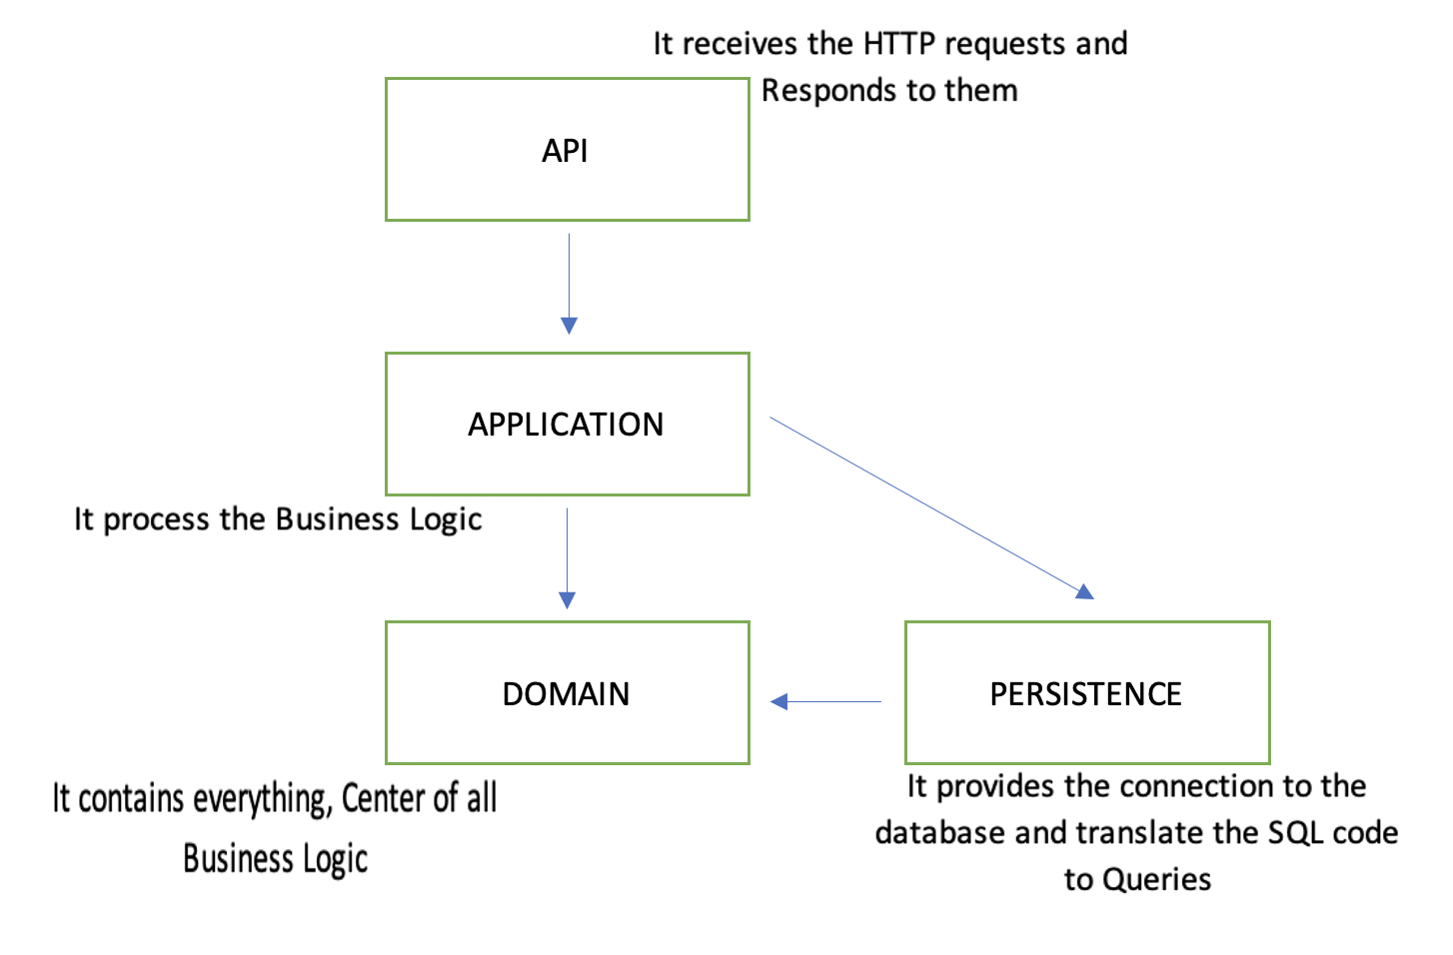
VIEW
ARCHITECTURE

Slide 4
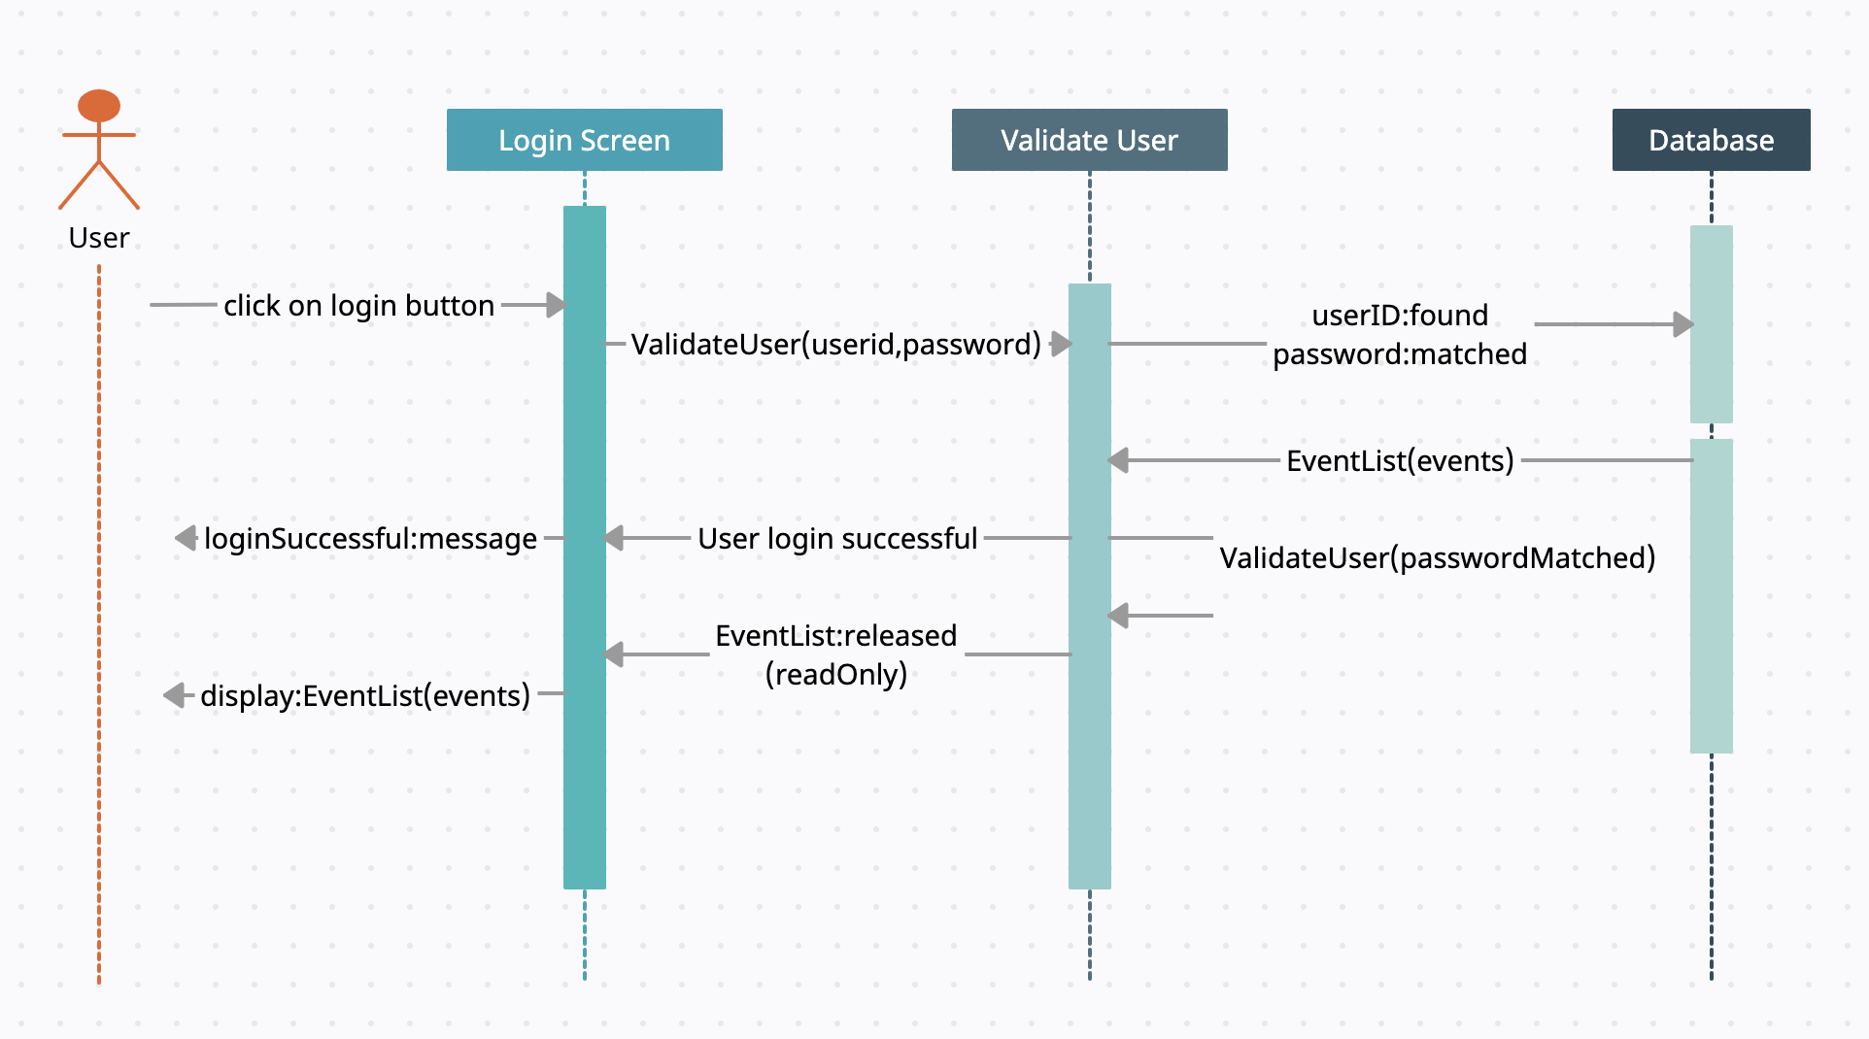
Sequence Diagram-Login

Slide 5
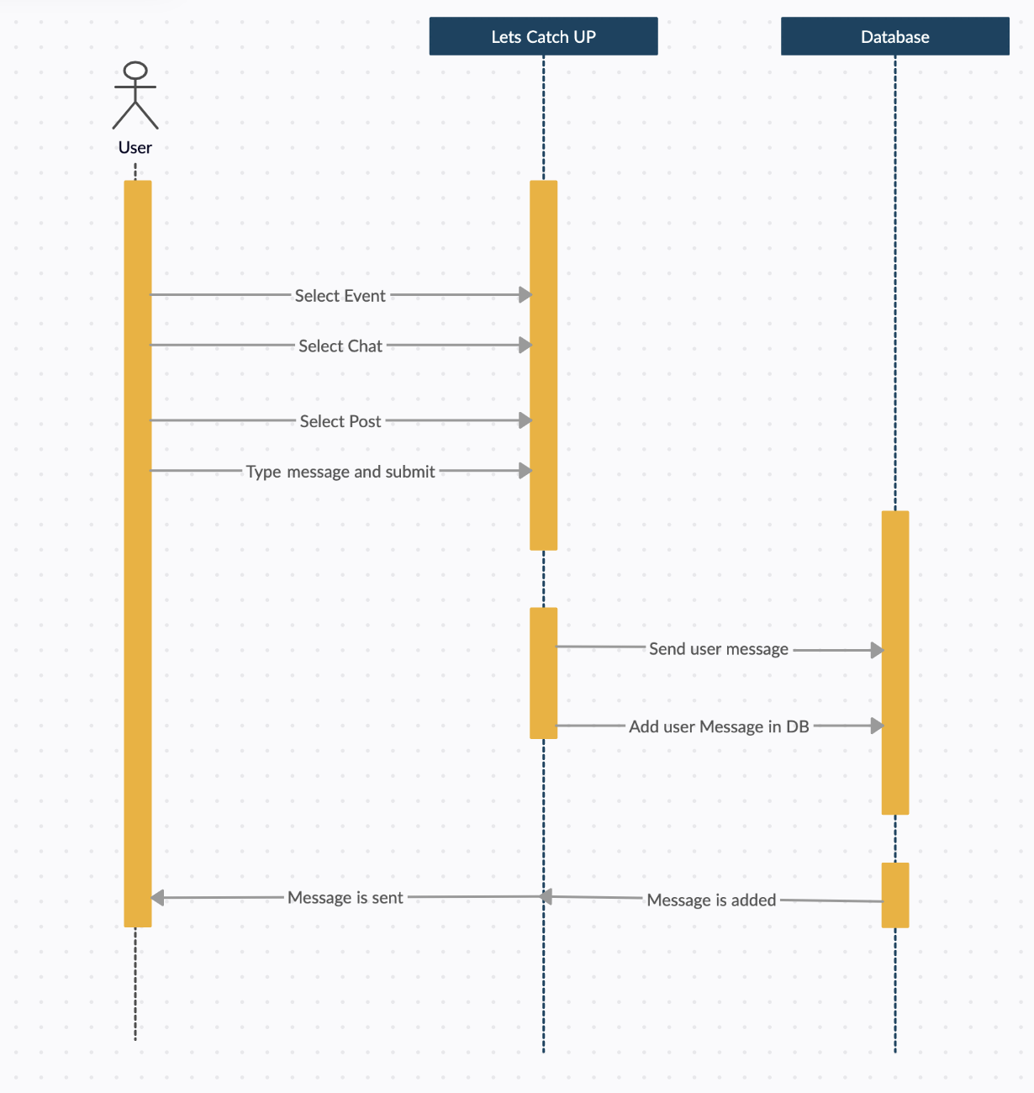
Sequence Diagram-Chat in a Post

Slide 6
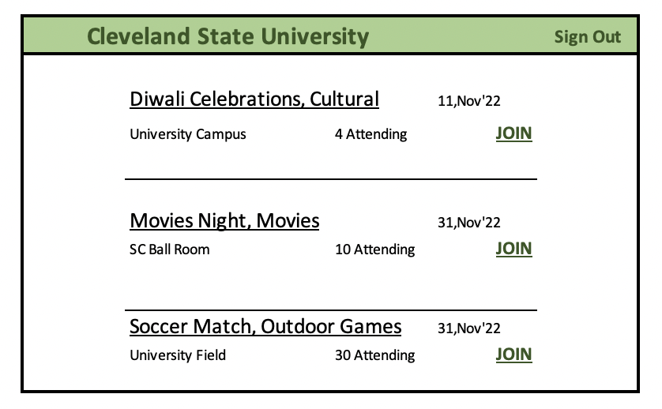


Home Page

Slide 7
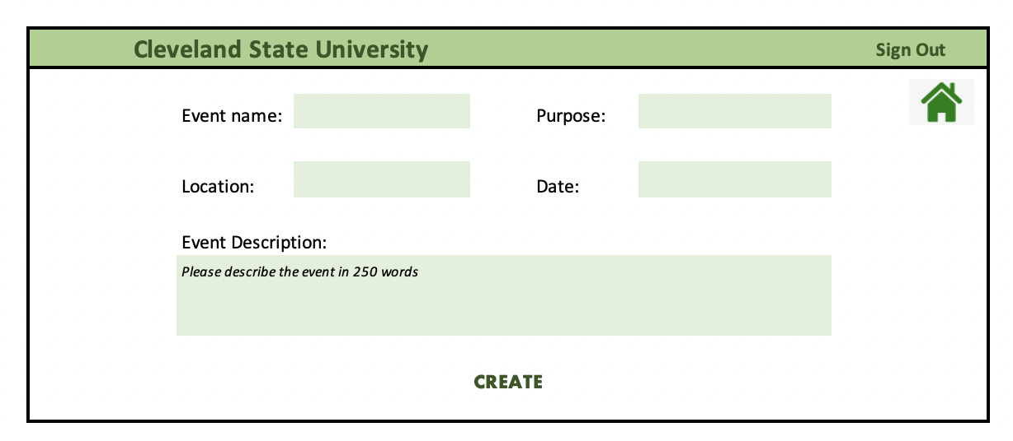
Event Create
Page

Slide 8
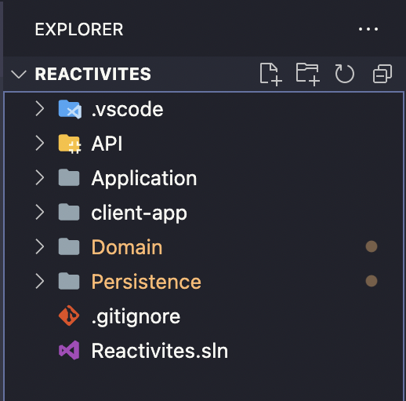
FILE STRUCTURE

